Slide 1
SS ZG622:
Software Project Management
(Introduction, Concepts & Terminology)
Prof K G Krishna, BITS-Pilani Off-Campus Centre, Hyderabad

Slide 2


Text Books
T1: Pressman, R.S. Software Engineering : A Practitioner’s Approach, 7th Edition, TMH, 2010
T2: Hughes, B and Cotterel, M., Software Project Management, 11th Edition, TMH, 2011
S1: Frank Tsui, Managing Software Projects, Jones&Bartlett, 2011
S2: Pankaj Jalote, Software Project Management in Practice, Pearson Education, 2002
Note: In order to broaden understanding of concepts as applied to Indian IT industry, students are advised to refer books of their choice and case-studies in their own organizations

Slide 3
Software Project Management:
Introduction, Concepts & Terminology
PPT Courtesy: Some of the content of this PPT is sourced from slides provided by Software Engineering: A Practitioner’s Approach, 7/e (McGraw-Hill 2009)
Hughes, B and Cotterel, M., Software Project Management, 11th Edition, TMH, 2011
.

Slide 4
TOPICS
Project – a technical definition
What makes Software Projects different?
Project Life-cycle
Project vs. Program
Role of Project Manager
Project Stakeholders
Measuring success of a project

Slide 5
What is a Project?
Project Defined
  A complex, non-routine, one-time effort limited by time, budget, resources, and performance specifications designed to meet customer needs.

Slide 6
Project Definition / Attributes
A project is unique, has specific time frame (not a continuing or on-going activity like automobile production, …), requires resources, interdependent activities, and has a degree of uncertainty.

Slide 7
Routine Work vs. Projects
Routine, Repetitive Work
Taking class notes
Daily entering sales receipts into the accounting ledger
Responding to a customer call
Writing a program for tax computation
Manufacture of an Apple iPhone
Projects
Writing a term paper
Setting up a sales desk for a professional accounting
Developing a customer support system
Developing a tax management system
Designing an iPhone that is approximately 2 X 4 inches, interfaces with iWatch, and stores 10,000 songs
TABLE 1.1

Slide 8
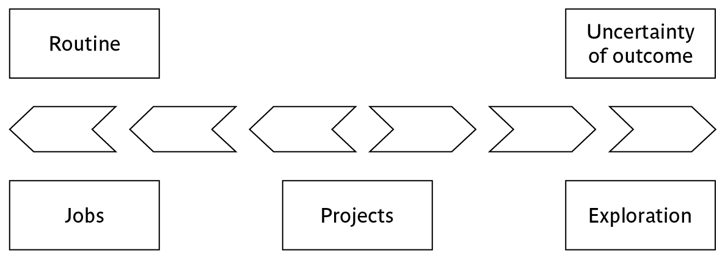
On Uncertainty scale:
Jobs (routine work) vs. Projects
‘Jobs’ – repetition of very well-defined and well understood tasks with very little uncertainty
‘Exploration’ – e.g. finding a cure for cancer: the outcome is very uncertain
Projects – in the middle!
Notes:
On the one hand there are repetitive jobs a similar task is carried out repeatedly, for example Kwikfit replacing a tyre on a car or a lecturer giving an introductory talk on project management. The task is well-defined and there is very little uncertainty. In some organizations, software development might tend to be like this – in these environments software process management might be more important than software project management
On the other hand some exploratory activities are very uncertain. Some research projects can be like this – we may not be sure what the outcome will be, but we hope that we will learn some things of importance. It may be very difficult to come up with precise plans, although we would probably have some idea of a general approach.
Projects seem to come somewhere between these two extremes. There are usually well-defined hoped-for outcomes but there are risks and uncertainties about achieving those outcomes.

Slide 9
Programs vs. Projects
Program Defined
  A series of coordinated, related, multiple projects that continue over an extended time and are intended to achieve a goal.
  A higher level group of projects targeted at a common goal.
  Example:
    Project: completion of a required course in project management.
    Program: completion of all courses required for a business major.

Slide 10
Summary:
Major Characteristics of a Project
Non-routine
Planned
Has an established objective (Project Goal)
Has a defined life span with a beginning and an end.
Requires across-the-organizational participation.
Involves doing something never been done before.
Has specific time, cost, and performance requirements
  Made up of several different phases
  Large / complex
  Has a Structured Methodology for Planning & Execution
  …

Slide 11
SS ZG622: Software Project Management – KG Krishna

Slide 12
Thank You
Next…> Activities/Phases in
Software Project Management
SS ZG622: Software Project Management – KG Krishna

Slide 13
What is management?
This involves the following activities:
Planning – deciding what is to be done
Organizing – making arrangements
Staffing – selecting the right people for the job
Directing – giving instructions
Measurements – of activities, effort, schedules, work-products,…
Monitoring – checking on progress
Controlling – taking action to remedy hold-ups
Innovating – coming up with solutions when problems emerge
Representing – liaising with clients, users, developers and other stakeholders
…
Notes:
This list is based on one that can be found in Introduction to Software Project Management and Quality Assurance by Darrel Ince, Helen Sharp and Mark Woodman, McGraw-Hill, 1993.

Slide 14
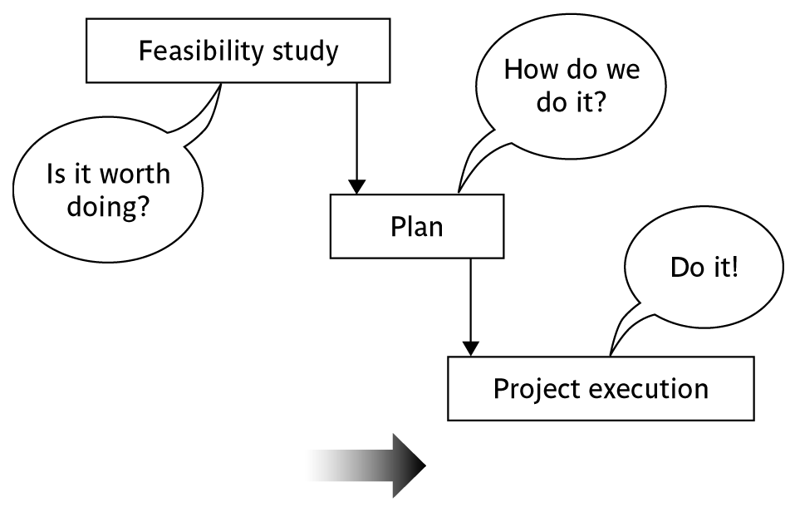
Activities covered by project management
Feasibility study
  Is project technically feasible and worthwhile from a business point of view?
Planning
  Only done if project is feasible
Execution
  Implement plan, but plan may be changed as we go along
Notes:
There are two key points here.
Often you see something like ‘feasibility study’ being put as the first stage of development life cycle, and indeed it might be. However, the recommendation of the feasibility study might be not to carry out the proposed project. Planning of the project should therefore take place after the feasibility study (or as a part of the feasibility study perhaps). Clearly the feasibility study itself might need a plan.
All plans are to some extent provisional and subject to change. The key point is that the evolving plan allows us to control the project.

Slide 15
In short, Project Management involves:
Typical Project Life Cycle (Generic, 4 phases, )
  Identifying need and inviting proposals
  Receiving and evaluating proposals and project selection
  Executing the project
  Terminating the project

Slide 16
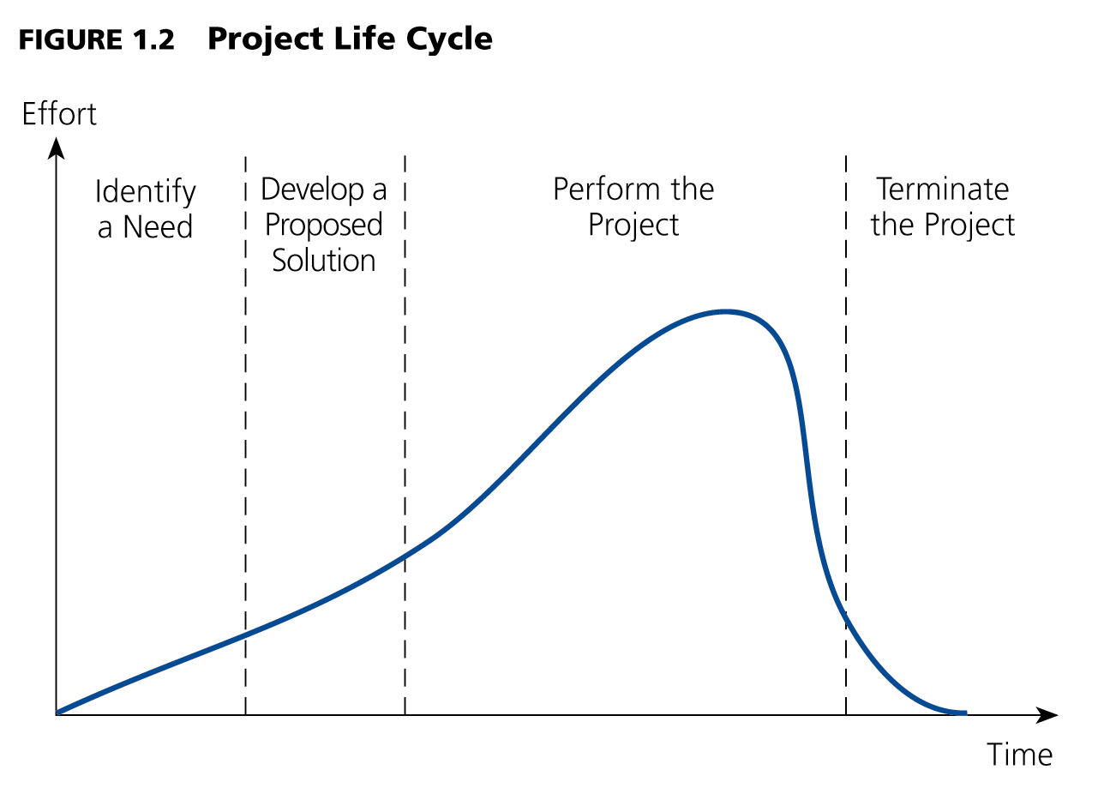
Project Life-cycle (Phases)
Stages (Phases) I II III IV

Slide 17
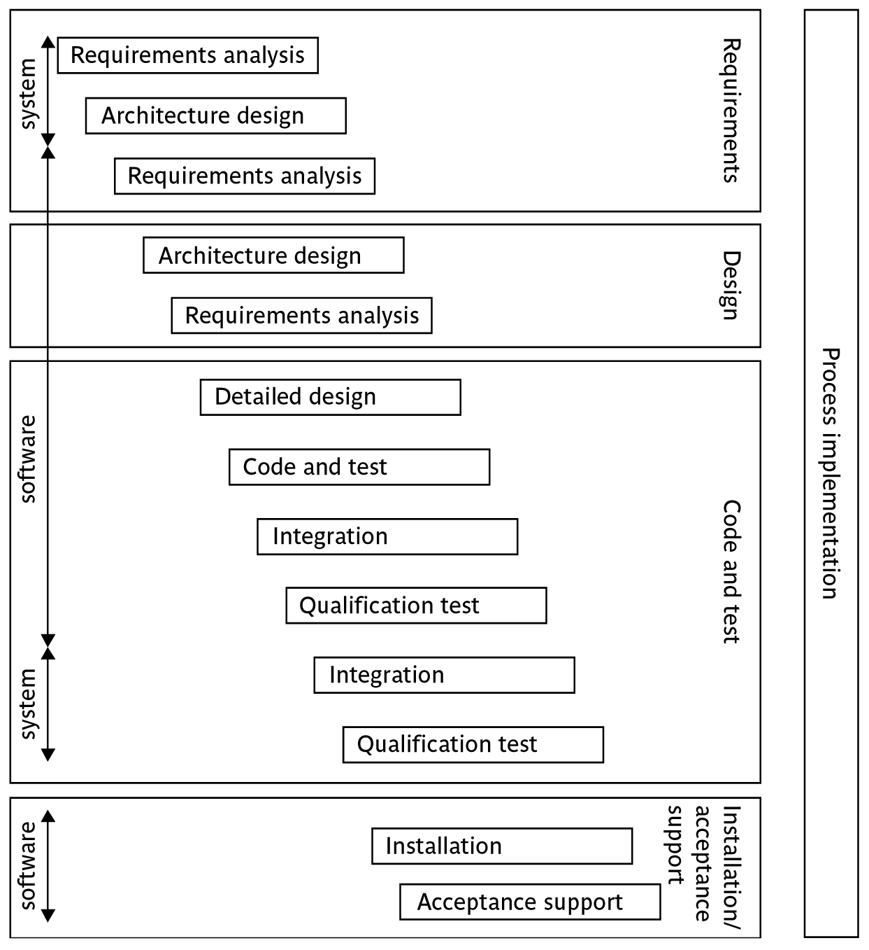
The software development life-cycle
(Ref: ISO 12207: Framework for Software Life-cycle Processes)
Notes:
This section of the lecture discusses the software development life cycle. Note that this is a technical model. It identifies the technical constraints on the order activities are done. This does NOT imply that a ‘waterfall’ approach is the only way to organize projects. The technical model could be implemented as increments or in an evolutionary manner.

Slide 18
Thank You
Next…> Challenges in Software Project Management
SS ZG622: Software Project Management – KG Krishna

Slide 19
The Challenge of Project Management
The Project Manager
  Manages temporary, non-repetitive activities and frequently acts independently of the formal organization.
    Marshals resources for the project.
    Has direct interface with customer and other stakeholders
    Provides direction, coordination, and integration to the project team.
    Is responsible for end-to-end performance and success of the project.
  Manages teams: induct right people at the right time; motivate teams for performance; resolves issues and conflicts
  Address issues by escalating at the right time and takes appropriate decisions
  …

Slide 20
The Importance of Project Management
Factors leading to the increased use of project management:
  Compression of the product life cycle
  Global competition
  Knowledge explosion
  Corporate downsizing (cost competitiveness)
  Increased customer focus
  Expansion of the economy and resultant opportunities
  …

Slide 21
Software Project Management!
  What is software project management? How Is it really different from management of other projects?
  How do you know when a project has been successful?
Notes:
The two key questions are:
What exactly is software project management?
This is going to be tackled by looking firstly at what is meant by ‘project’. We are then going to examine whether ‘software project management’ is really different from ‘normal’ project management. Is there anything special about software as opposed to other engineered artefacts?
2. How do we define whether a project is a success or not?
The point about studying project management is to be able to have successful projects. So how do we know if we have been successful?

Slide 22
Why is software project management important?
Large amounts of money are spent on ICT
Project often fail – Standish Group claim only a third of ICT projects are successful. 82% were late and 43% exceeded their budget.
Poor project management a major factor in these failures
Notes:
The methodology used by the Standish Group to arrive at their findings has been criticized, but the general perception of the prevalence of ICT project failure is still clear.

Slide 23
Are software projects really different from other projects?
Not really …but
Invisibility
Complexity
Conformity
Flexibility
Changing Requirements
Skill Requirements
…
make software more problematic to build than engineered artefacts in other fields
Notes:
This is based on Fred Brooks’ paper No Silver Bullet: Essence and Accidents of Software Engineering which appeared in IEEE Computer 20(4) pp10-19 April 1987

Slide 24
Thank You
Next…> Project Stakeholders &
Success Criteria
SS ZG622: Software Project Management – KG Krishna

Slide 25
Professional Software Development employs formal Methods:
Methodology = a set of methods
Context
Plan
Methods
+ start and end dates for each activity,
staffing, tools and materials etc
A way of working
Notes:
A plan of an activity must be based on some idea of a method of work. While a method relates to a type of activity in general, a plan takes one or more methods and converts them into real activities by identifying:
Start and end dates
Who will carry it out
What tools and materials would be needed.
A methodology is a set of related methods. Strictly speaking ‘methodology’ ought to mean the study of methods!

Slide 26
Project Stakeholders
These are people who have a stake or interest in the project
In general, they could be users/clients or developers/implementers
They could be:
  Within the project team
  Outside the project team, but within the same organization
  Outside both the project team and the organization (society,…)
Different stakeholders may have different objectives – need to define common project objectives
Notes:
Each stakeholder will have their own goals and concerns in relation to the project which may be different from those of the project as a whole. For example, a software developer might work to make a living, pay the mortgage, learn new things, solve interesting problems. The main stakeholders need, however, to understand and accept overall project objectives that everyone can agree to.
See Exercise 1.6 in the text.

Slide 27
Project success/failure
Degree to which objectives are met
Quality, Scope (of deliverables)
time
cost
In general if, for example, project is running out of time,
this can be recovered for by reducing scope or increasing
costs. Similarly costs and scope can be protected by
adjusting other corners of the ‘project triangle’.

Slide 28
Other success criteria
These can relate to longer term, less directly tangible assets
  Improved skill and knowledge
  Creation of assets that can be used on future projects e.g. software libraries
  Improved customer relationships that lead to repeat business
  …

Slide 29
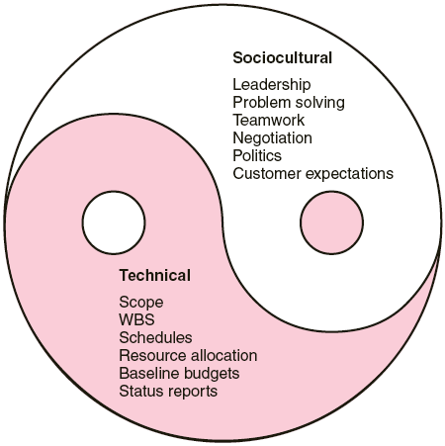
Social & Technical aspects of
Project Management

Slide 30
Summary
Projects are non-routine – thus there is an element of uncertainty
In addition, managing software projects involve dealing with complexity, uncertain or changing requirements
The role of a Project Manager is well-defined and he/she is responsible for the success of the project managing teams, stakeholders and resources
Professional Software Development involves adoption of formal Software Engineering Models

Slide 31
Thank You
Any Questions?

